Slide 1

#OSTogether

Slide 2

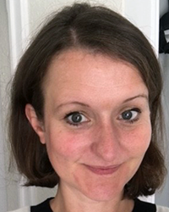
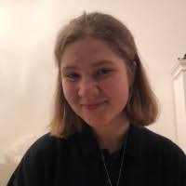
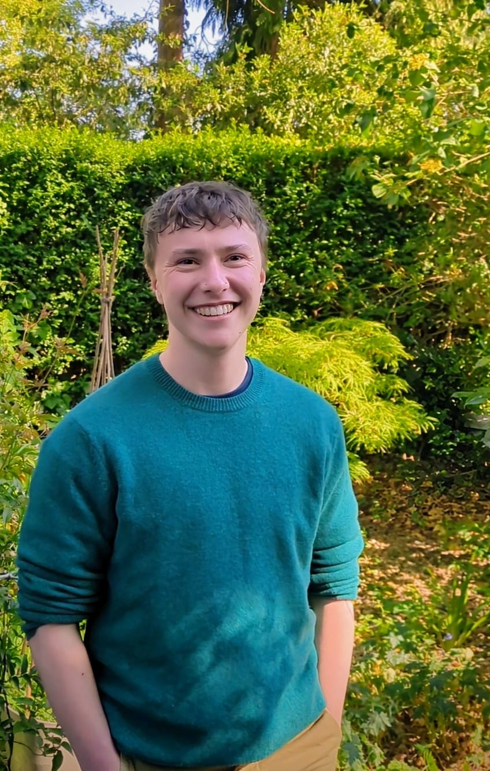
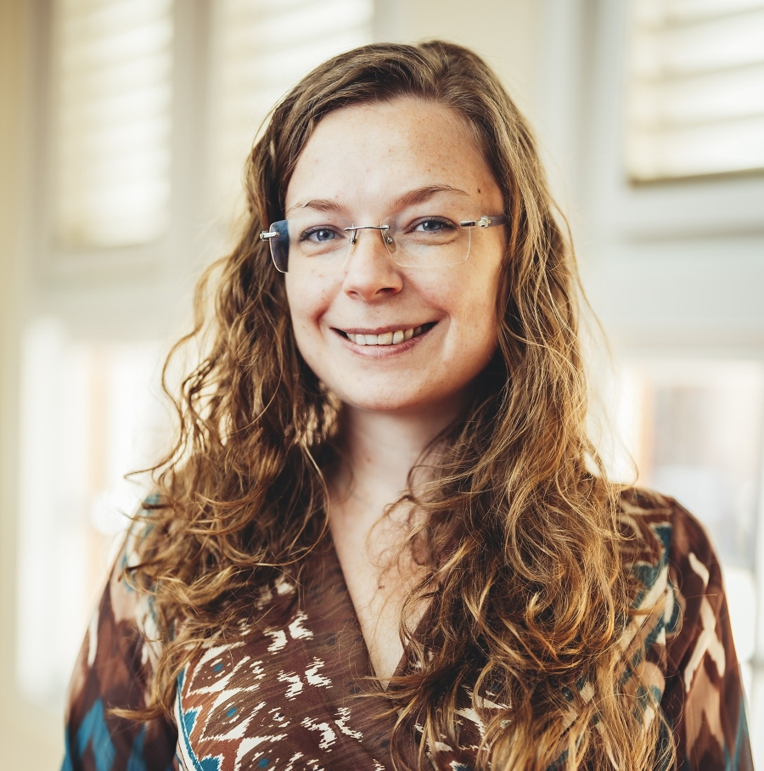

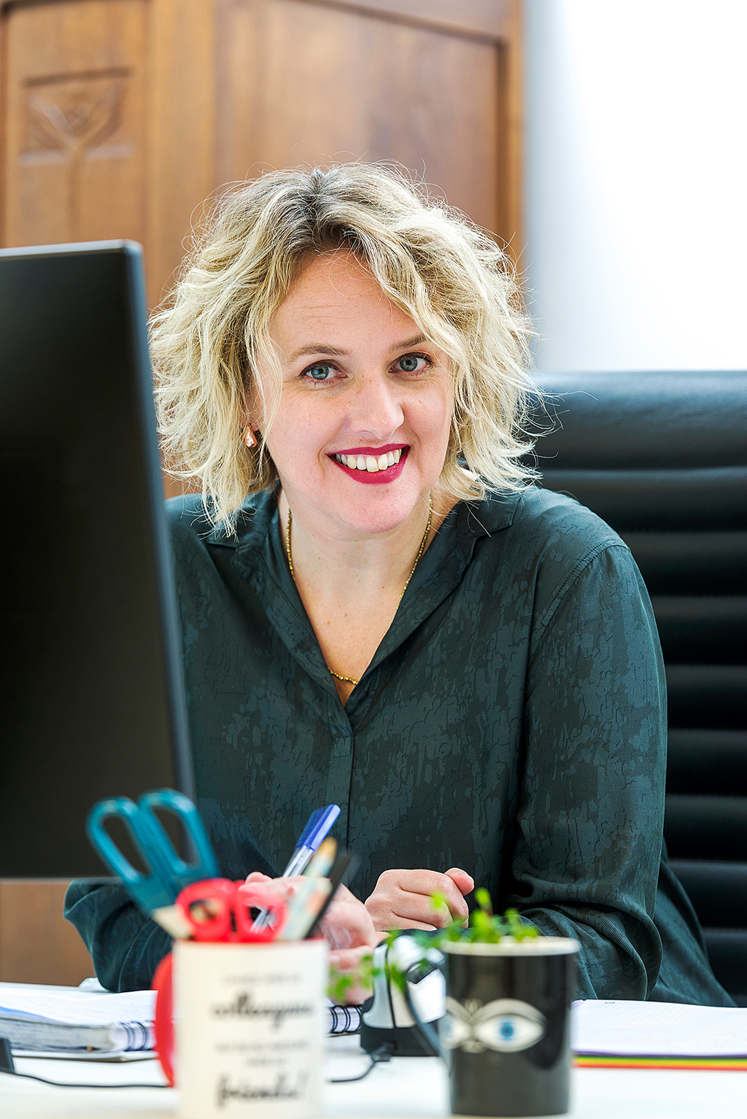
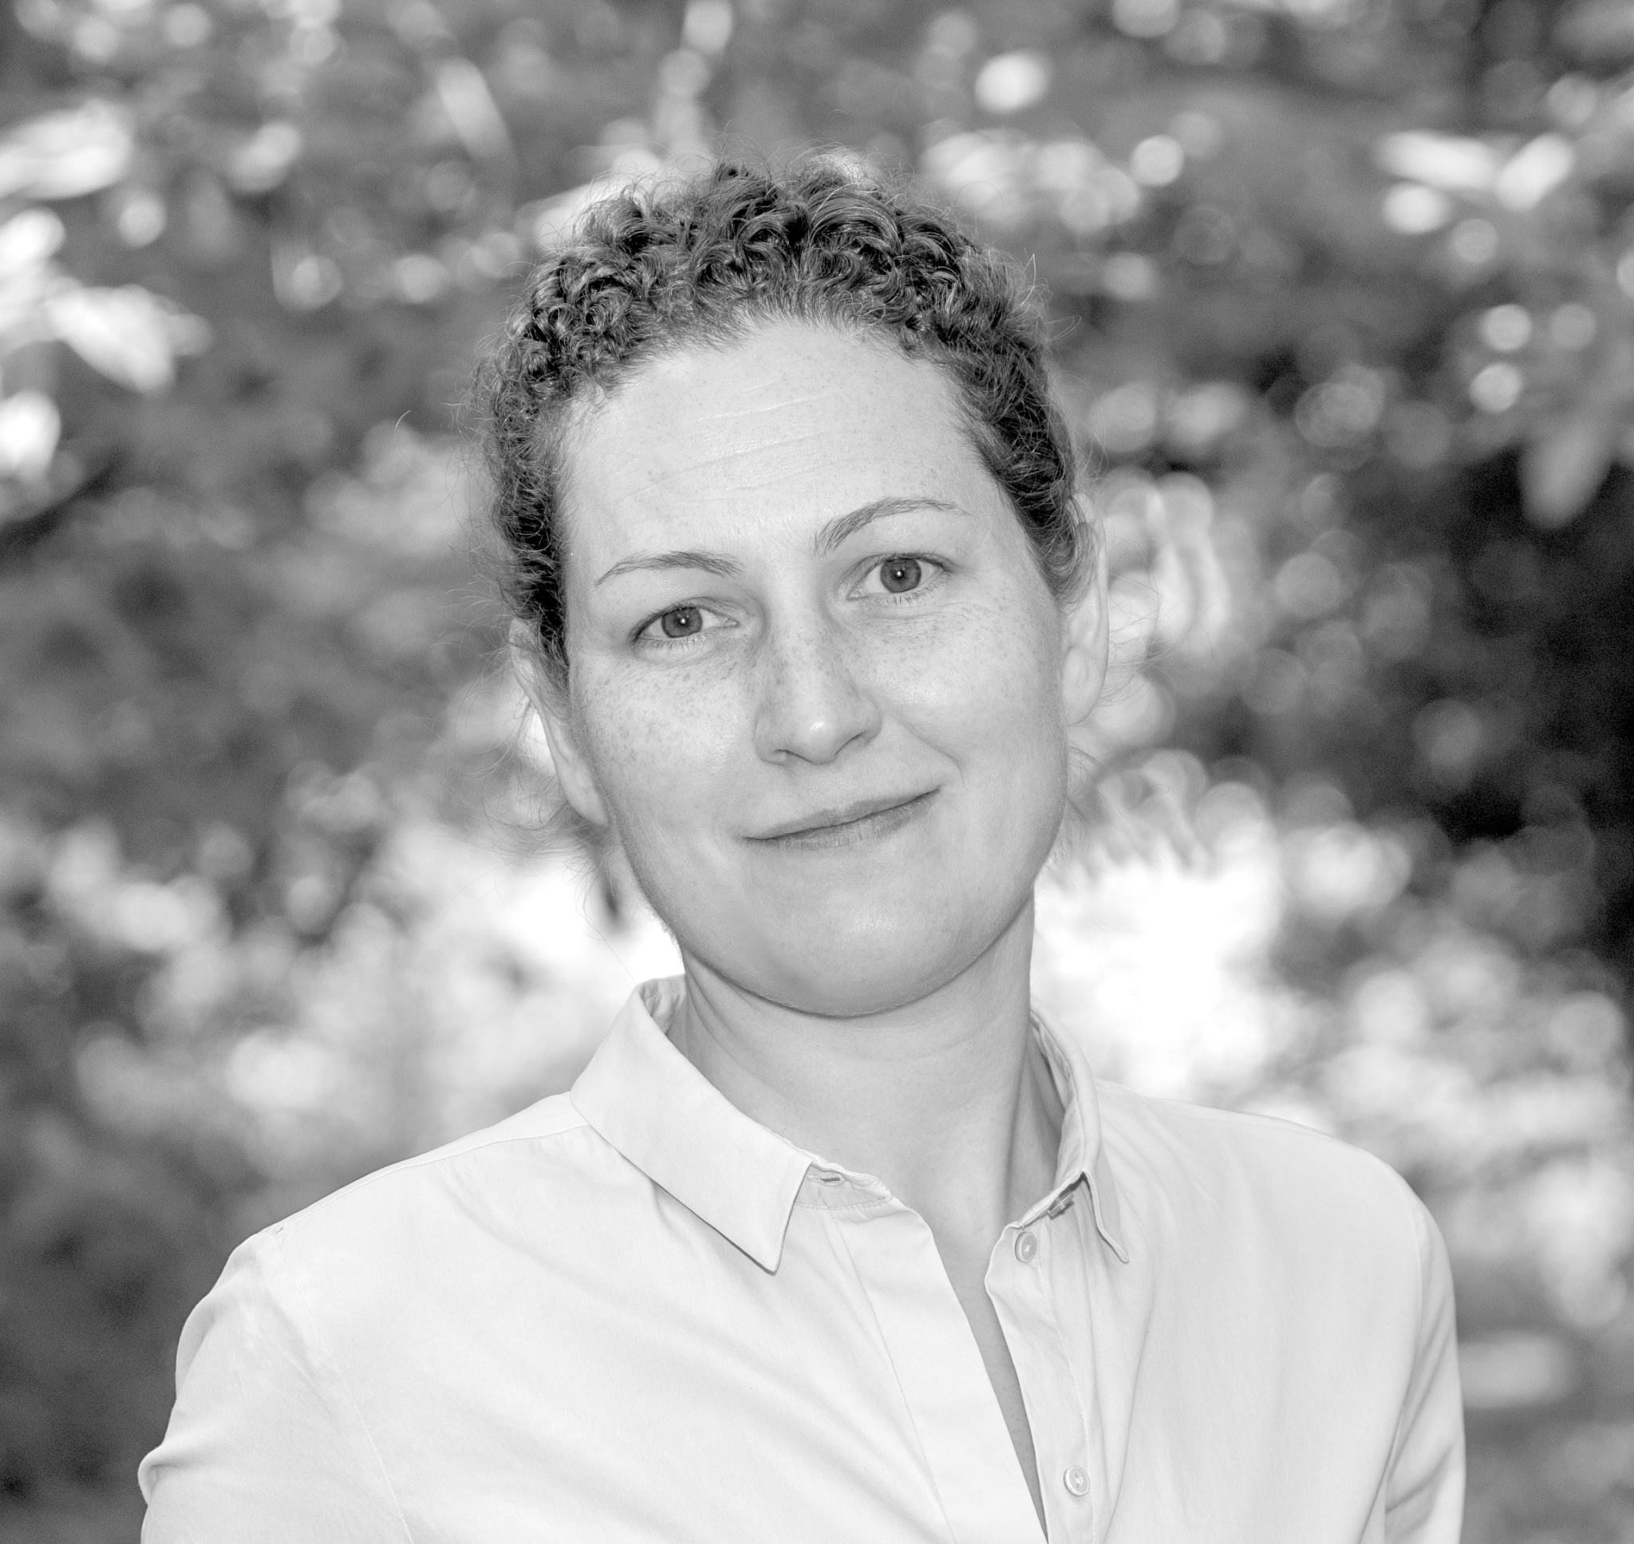
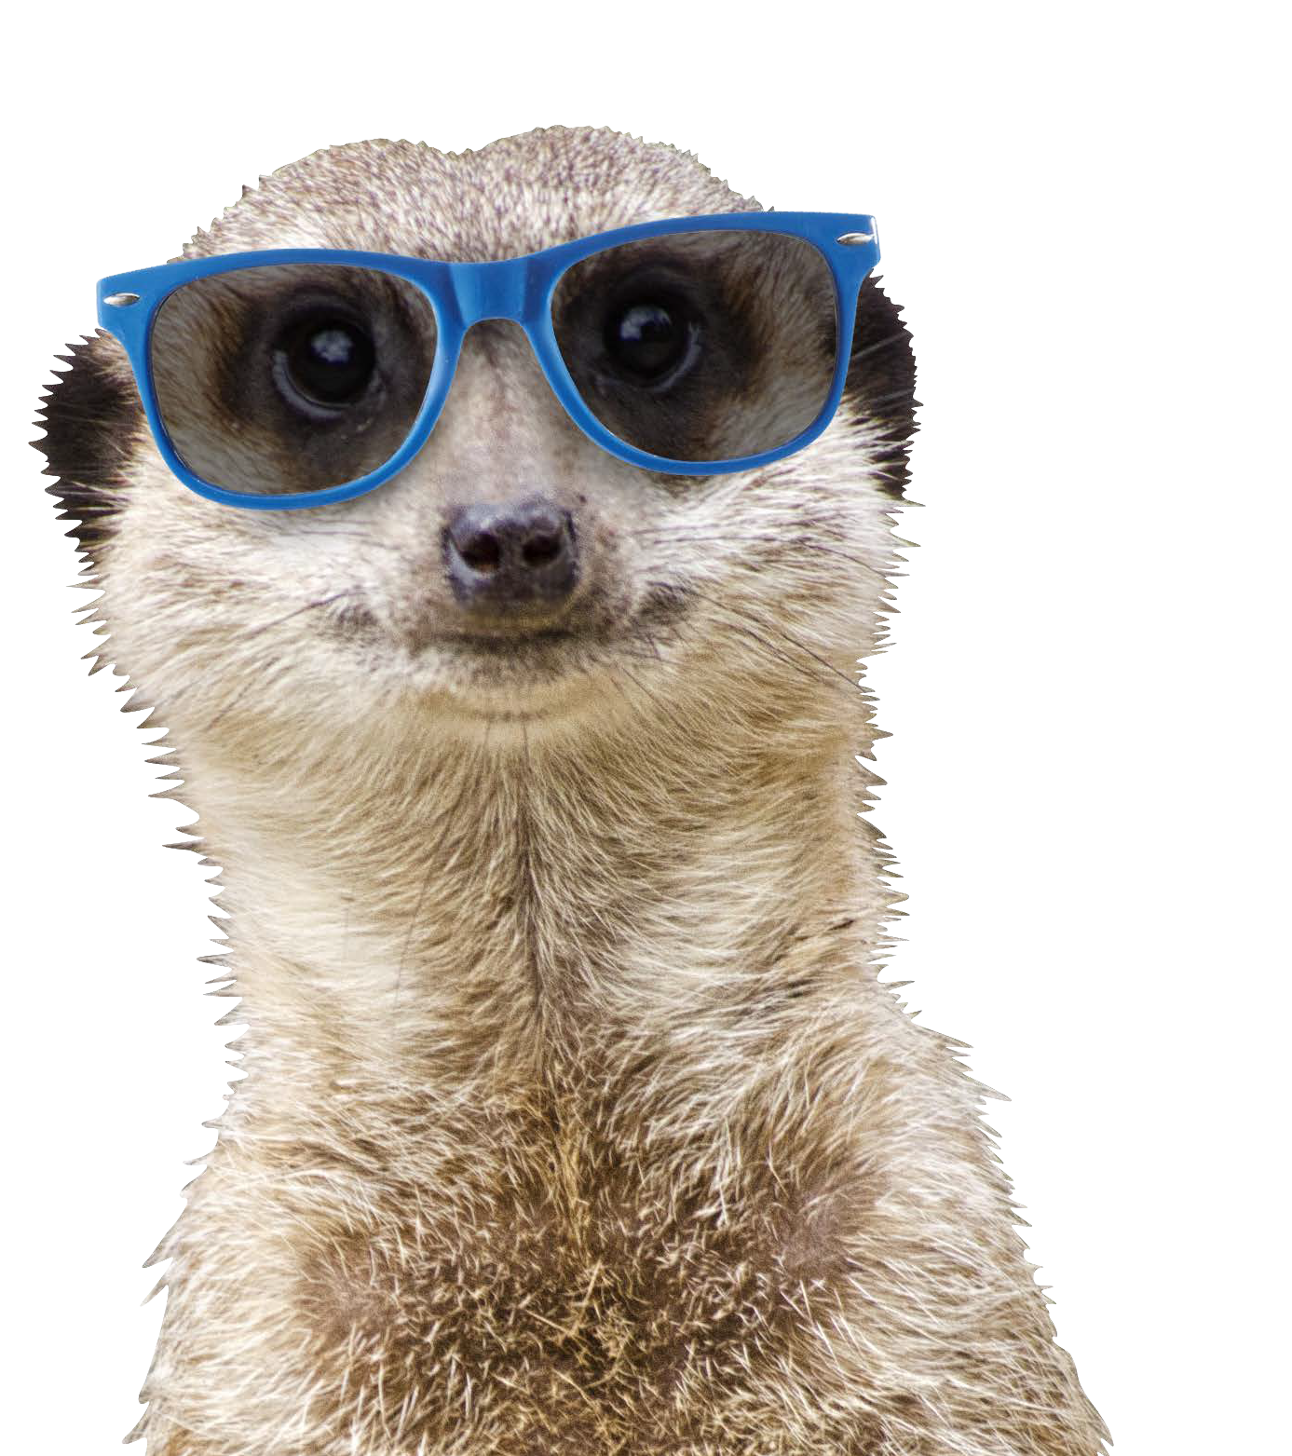
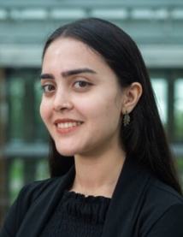
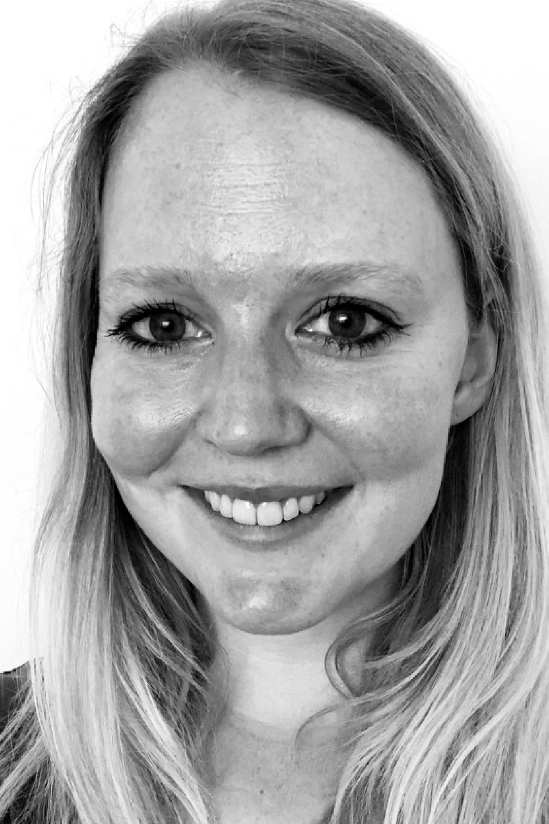
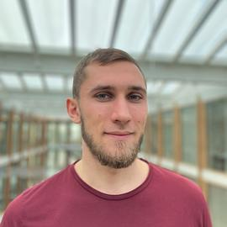
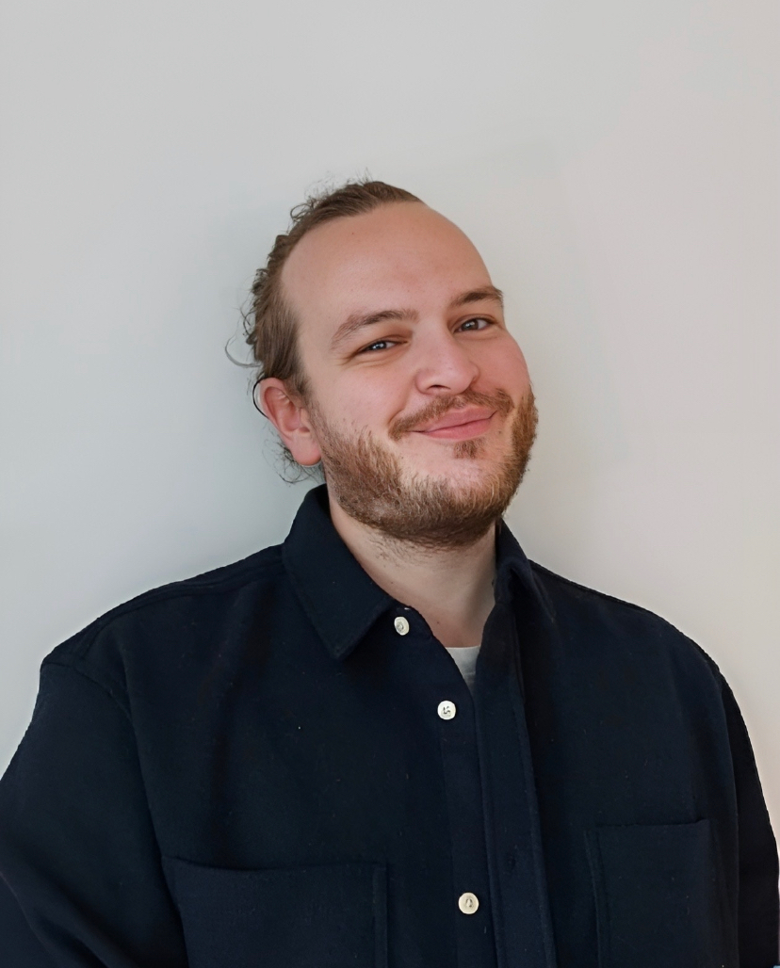

Welcome!
Louise Bezuidenhout
Charlotte Rönnau
Ze Freeman
Esther Plomp
Melanie Imming
Anna van ‘t Veer
Thomas Gültzow
Afreen Khalid
Hanne Zimmermann
Max Primbs
Notes:
Welcome on behalf of all organizers and speakers by Anna van ‘t Veer

Slide 3
Another thank you for being here
Motivations:
-Coming together to fight injustice;
-Incorporating this in my own events, policy-making;
-Measuring marginalized groups and giving them a voice;
-Supporting researchers in inclusive way;
-Do research with populations that have not been visible so far, etc.
“As someone who is slowly gaining a more senior position in academia, I think it is valuable to consciously reflect on issues related to equity, diversity, & inclusion. I now have a role where I can influence the system and be responsible for junior colleagues, which very is new to me. With increasing power comes increasing responsibility, and I'd like to learn more about how to be a force for good in my role.”

Slide 4
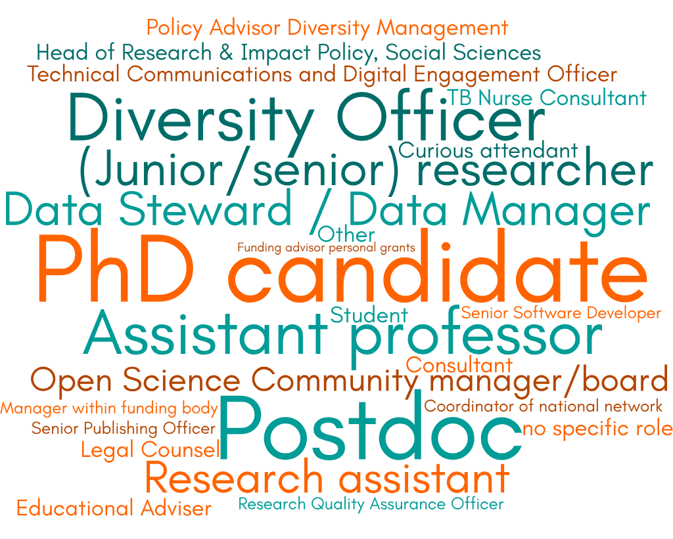
Who you are

Slide 5
Who you are
My current role is: | Motivation:
great | Anna talked me into this

Slide 6
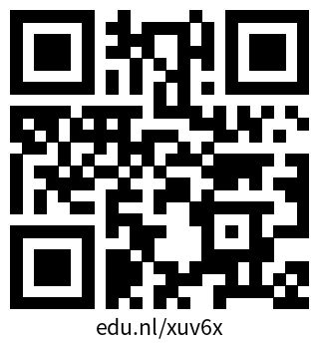
Code of Conduct
Online reporting form:
Please be reminded that by registering for this event, you agreed to uphold the Code of Conduct of the International Network of Open Science Communities. If someone makes you or anyone else feel unsafe or unwelcome, or if you believe you’ve witnessed harassment, please report it as soon as possible to the code of conduct committee of the event, recognisable by their badge, either in person or electronically via the online form (scan QR).
Thomas Gültzow
Melanie Imming
Esther Plomp
Max Primbs
Anna van ‘t Veer

Slide 7
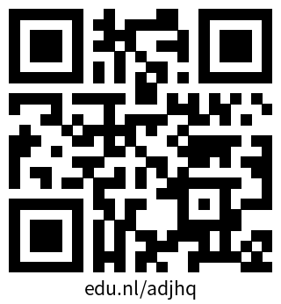
Programme
Opening 10:00 - 10:30 | You made it! Anna van ‘t Veer & Louise Bezuidenhout
Morning session 10:30 - 12:30 | Break in Café de Iris: 11:15-11:45
Lunch 12:30 - 14:00 | De Refter (2 mins from building, choose from food court with voucher)
Afternoon session 14:00 - 15:30 | Small break midway
Closing 15:35 - 16:00 | Back here in MM 00.025
Mingle & meet 16:00 - 17:00 | Café de Iris

Slide 8
Sessions!
Leveling the playing field for careers in science & measuring marginalization (Afreen Khalid, Ze Freeman): MM 01.075
Inclusive events, work environments and building ally skills (Esther Plomp, Melanie Imming): MM 03.610
Equity, Diversity, & Inclusion in the research lifecycle (Thomas Gültzow): MM 02.110 (morning), MM 02.630 (afternoon)

Slide 9
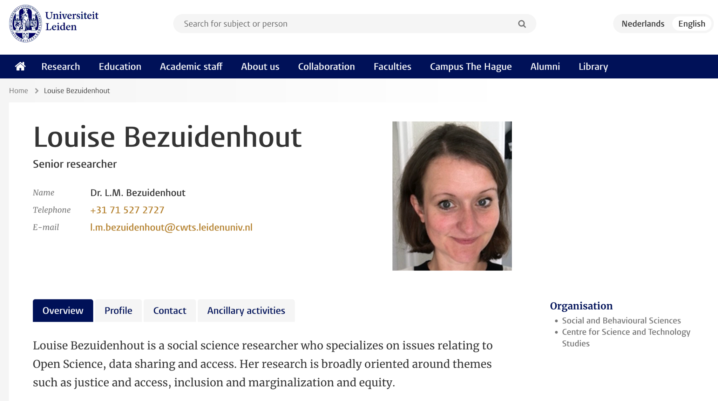
Louise Bezuidenhout

Slide 10
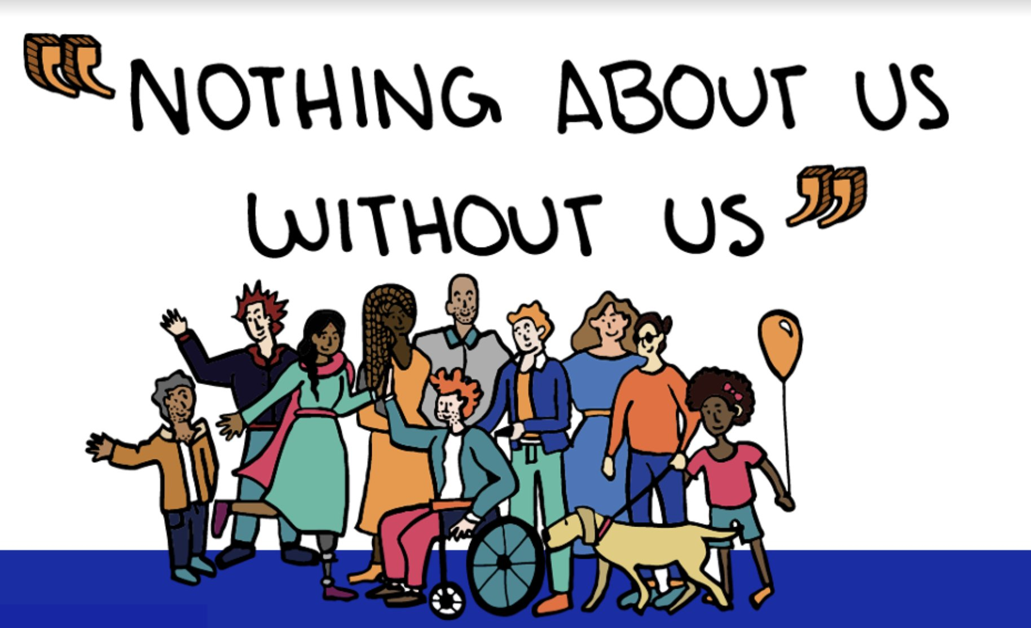
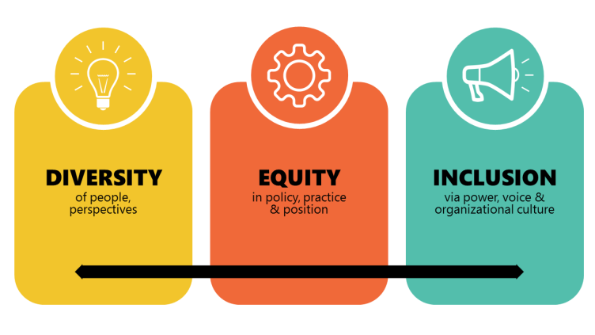

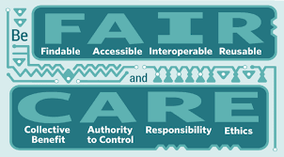
Equity in Research
link
link

Slide 11
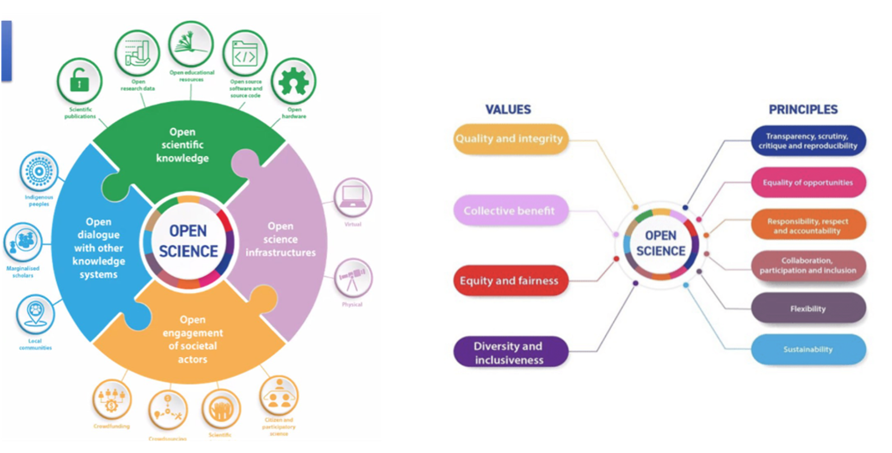
UNESCO Recommendation on Open Science
“Open science is a set of principles and practices that aim to make scientific research from all fields accessible to everyone for the benefits of scientists and society as a whole. Open science is about making sure not only that scientific knowledge is accessible but also that the production of that knowledge itself is inclusive, equitable and sustainable.”

Slide 12
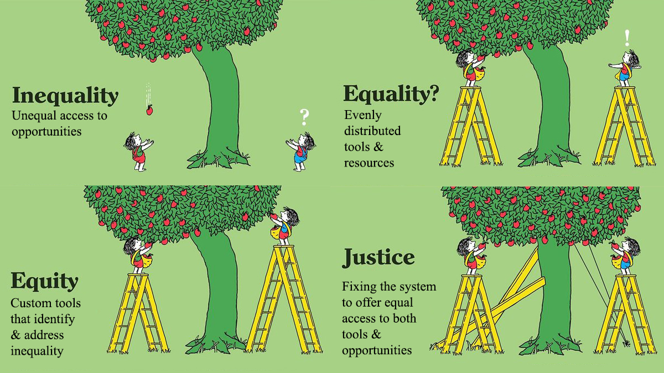
Inclusive infrastructures
Open Science
How do we extend our relational thinking of equity to research infrastructures and resource management?
Inclusive community
Inclusive tools and outputs
Tony Ruth

Slide 13

What Should Equity Look Like for Open Science?
Is it enough that everyone can access online resources?
Meaningfully access open digital resources with similar effort (language, bandwidth, device etc)?
Be able to use the same resources for desired purposes?
Have support for engaging with OS resources?
Have knowledge structured in ways that reflect culture?
Have data stored in-country and retaining control over indigenous knowledge?
Contribute knowledge and resources - not just consume?
What does equitable openness of scientific knowledge and scientific infrastructures really mean?

Slide 14
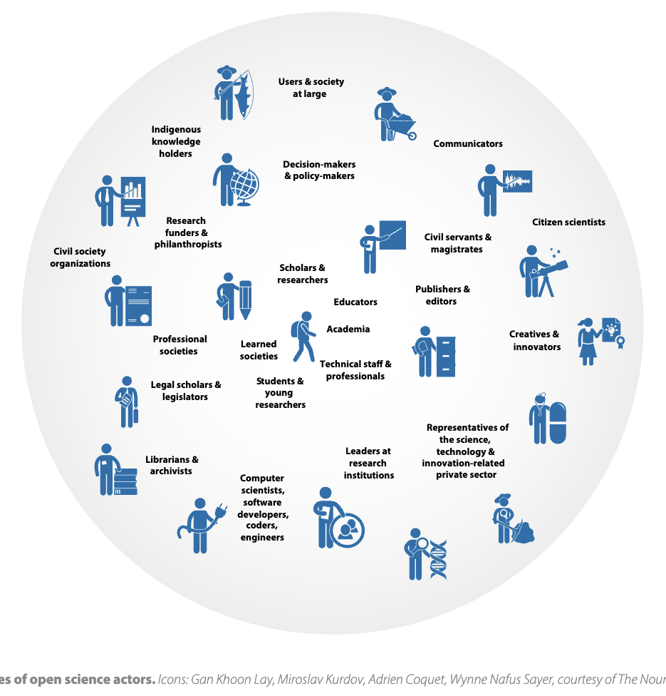
Equity for Whom?
Infinite number of societal actors
Different challenges, needs and approaches to engaging with digital resources
Solutions for one community may marginalise another
Finite resources
Support systems vary considerably
Interoperability of equity responses not guaranteed

Slide 15
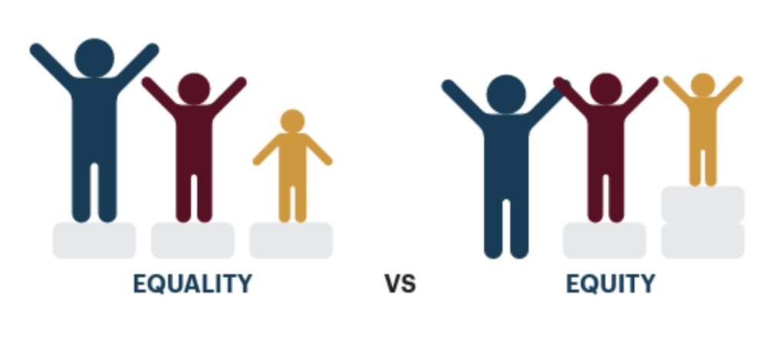
Equity Supported By What?
“Inherited” infrastructures designed for sharing digital resources not necessarily equity
Infrastructures reflect specific values and practices
Unequal global distribution of researchers/ infrastructures affects evolution of Open Science landscape
Highly heterogeneous funding of research globally - commercial, governmental, community-led
Lack of money to “retro-fit” equity
“Retro-fitting” equity to infrastructures is difficult

Slide 16
Equity Supported By Whom?
UNESCO Recommendation not prescriptive on how equity is enacted
Addressing equity has a strong cultural component
Different countries have different national priorities for equity and inclusion - reflects historical past and current vulnerable communities
Varying levels of support for equity agendas in and beyond research
Current reliance on individual researchers making strategic equity/inclusion decisions which relies on personal positions and priorities

Slide 17
Locally Appropriate vs Globally Applicable
There will never be a “one size fits all” approach to equity
Different individuals and communities have different challenges and are entitled to tailored solutions
However, addressing one community might negatively impact another
Intersectionality of vulnerabilities further complicates approaches
Different research systems/communities have different historical legacies that influence engagement with Open Science
Activities may not always link up/be translatable - how to share best practice and foster multifaceted equity?

Slide 18
Challenges to Equity
Resource producers
Need reward and recognition for their contributions
Require training and financial/technical support
Individualised equity actions mean a lot of heterogeneity
Resource users
May have different contextual challenges and needs
Different knowledge systems structure information differently
Potential training and science literacy gaps
Resource infrastructures
Require funding
Subject to geo-political pressures
Dependent on national and international infrastructures

Slide 19
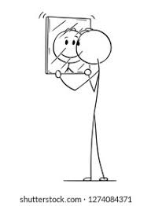
Enacting Equity Through Empathy and Humility
Equity requires critical interrogation of frame of reference
Everyone has a personal vision of user communities and their challenges
Vital to continually challenge these self-perceptions
Recognizing that different people have different understandings of equity and hierarchies of priorities
Empathy and humility fundamental to enacting empathy
Dialogue - be willing to ask the uncomfortable questions

Slide 20
Finding your session
Programme:
Leveling the playing field for careers in science & measuring marginalization (Afreen Khalid, Ze Freeman): MM 01.075
Inclusive events, work environments and building ally skills (Esther Plomp, Melanie Imming): MM 03.610
Equity, Diversity, & Inclusion in the research lifecycle (Thomas Gültzow): MM 02.110 (morning) MM 02.630 (afternoon)
Notes:
After this opening, and right after lunch at 14, you can pick from 3 sessions

Slide 21
#OSTogether
Notes:
Closing by Max

Slide 22
You will receive an email with links

Slide 23
Closing
Closing 15:35 - 16:00 | Back here in MM 00.025
Mingle & meet 16:00 - 17:00 | Café de Iris

